Slide 1
Interest Rate Options
Chapter 21

Slide 2
Exchange-Traded Interest Rate Options
Treasury bond futures options
Eurodollar futures options

Slide 3

Treasury Bond Futures Option
Suppose March T-bond call futures option with strike price of 110 is 2-06 (This is 2 )
This means one contract costs $2,093.75
On exercise it provides a payoff equal to 1000 times the excess of the March T-bond futures quote over 110

Slide 4
Eurodollar Futures Option
Suppose that the quote for a June Eurodollar put futures option with a strike price of 96.25 is 59 basis points
One contract costs 59×$25 = $1,475
On exercise it provides a payoff equal to the number of basis points by which 96.25 exceeds the June Eurodollar futures quote times $25

Slide 5
Embedded Bond Options (page 460)
Callable bonds: Issuer has option to buy bond back at the “call price.” The call price may be a function of time
Puttable bonds: Holder has option to sell bond back to issuer

Slide 6
Black’s Model & Its Extensions
Black’s model is used to value many interest rate options
It assumes that the value of an interest rate, a bond price, or some other variable at a particular time T in the future has a lognormal distribution
The payoff is discounted from the time of the payoff to today at today’s risk-free rate

Slide 7
European Bond Options
When valuing European bond options it is usual to assume that the future bond price is lognormal

Slide 8
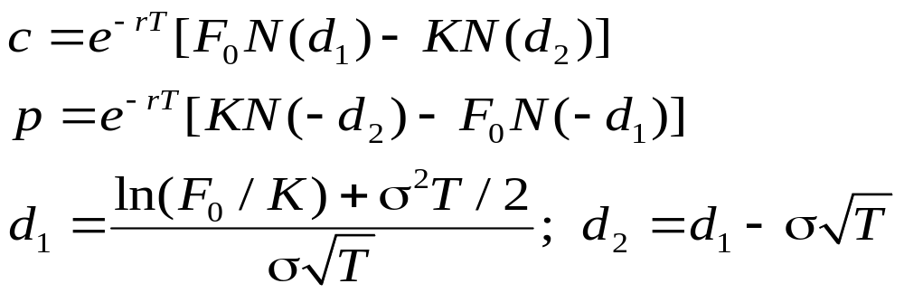
European Bond Options continued
F₀ : forward bond price today
K : strike price
r : risk-free interest rate for maturity T
T : life of the option
σ : volatility of forward bond price

Slide 9
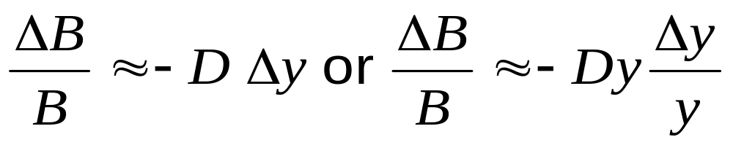
Yield Vols vs Price Vols
The change in forward bond price is related to the change in forward bond yield by
where D is the (modified) duration of the forward bond at option maturity

Slide 10
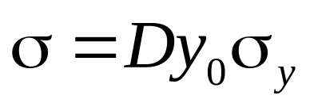
Yield Vols vs Price Vols continued
This relationship implies the following approximation
where σ_{y} is the yield volatility and y₀ is the forward bond yield today
Market practice to quote σ_{y} with the understanding that this relationship will be used to calculate σ

Slide 11
Cash vs Quoted Bond Price
The bond price and strike price used in Black’s model should be cash (i.e. dirty) prices not quoted (i.e. clean) prices
The cash price is the quoted price plus accrued interest.
The forward bond price, F₀, is (B − I)e^{rT} where B is the cash bond price and I is the present value of coupons received during the option’s life

Slide 12
Caps and Floors
A cap provides payoffs to compensate the holder for situations when LIBOR is above above a certain level (the cap rate)
A floor provides payoffs to compensate the holder for situations where LIBOR is below a certain level (the floor rate)

Slide 13
Example
The principal is $10 million and in a 2 year cap (floor) with quarterly resets the cap rate is 4%
What are the payoffs in the cap (floor) if 3-month LIBOR in successive quarters are 3%, 3%, 3.5%, 4.5%, 5%, 4%, 3.5%, and 3.5%
When are the payoffs realized?

Slide 14
Caplet
A caplet is one element of a cap
Suppose that the reset dates in a cap are t_{1,} t₂, ….t_{n} and δ_{k} = t_{k+1} −t_{k}
Suppose R_{K} is the cap rate, L is the principal, and R_{k} is the actual LIBOR rate for the period between time t_{k} and t_{k+1} . The caplet provides a payoff at time t_{k+1} of
Lδ_{k} max(R_{k}−R_{K}, 0)
for k=1, 2...n.
Standard practice is for no payoff for the first period between time zero and t₁

Slide 15
Caps
A cap is a portfolio of caplets
Each caplet can be regarded as a call option on a future interest rate with the payoff occurring in arrears
When using Black’s model we assume that the interest rate underlying each caplet is lognormal

Slide 16
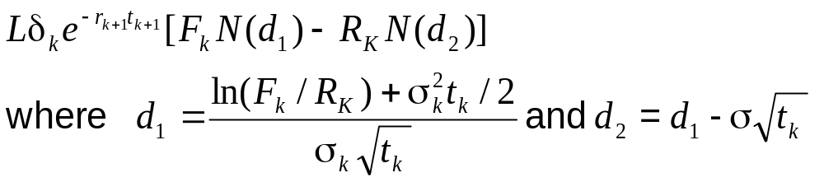
Black’s Model for Caps
(Equation 21.8, page 466)
The value of a caplet, for period [t_{k}, t_{k+1}] is
F_{k} : forward LIBOR interest rate
for (t_{k}, t_{k+1})
σ_{k} : forward interest rate vol.
r_{k} : risk-free interest rate for maturity t_{k}
L: principal
R_{K}: cap rate δ_{k}=t_{k+1}-t_{k}

Slide 17
When Applying Black’s Model
To Caps We Must ...
EITHER
  Use forward volatilities
  Volatility different for each caplet
OR
  Use flat volatilities
  Volatility same for each caplet within a particular cap but varies according to life of cap

Slide 18
European Swap Options
A European swap option gives the holder the right to enter into a swap at a certain future time
Either it gives the holder the right to pay a prespecified fixed rate and receive LIBOR
Or it gives the holder the right to pay LIBOR and receive a prespecified fixed rate

Slide 19
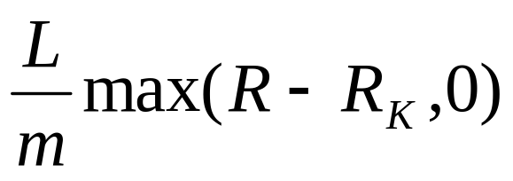
European Swaptions
When valuing European swap options it is usual to assume that the swap rate is lognormal
Consider a swaption which gives the right to pay R_{K} on an n -year swap starting at time T . The payoff on each swap payment date is
where L is principal, m is payment frequency and R is market swap rate at time T

Slide 20
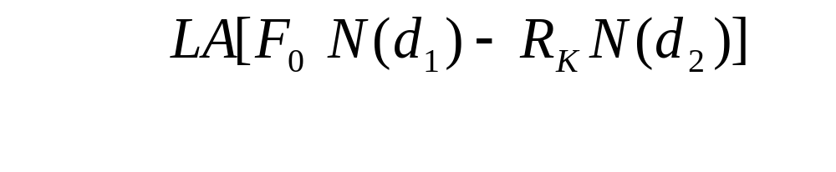
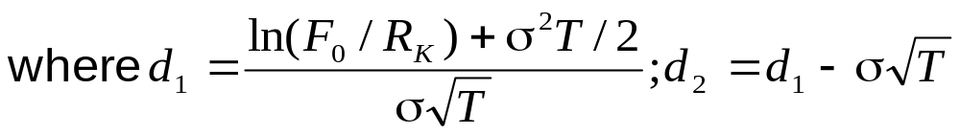
European Swaptions continued
(Equation 21.10, page 471)
The value of the swaption is
F₀ is the forward swap rate; σ is the swap rate volatility; t_{i} is the time from today until the i th swap payment; and A is the value today of a annuity paying $1 on each payment date

Slide 21
Relationship Between Swaptions and Bond Options
An interest rate swap can be regarded as the exchange of a fixed-rate bond for a floating-rate bond
A swaption or swap option is therefore an option to exchange a fixed-rate bond for a floating-rate bond

Slide 22
Relationship Between Swaptions and Bond Options (continued)
At the start of the swap the floating-rate bond is worth par so that the swaption can be viewed as an option to exchange a fixed-rate bond for par
An option on a swap where fixed is paid & floating is received is a put option on the bond with a strike price of par
When floating is paid & fixed is received, it is a call option on the bond with a strike price of par

Slide 23
Term Structure Models
American-style options and other more complicated interest-rate derivatives must be valued using an interest rate model
This is a model of how a particulare term structure interest rates moves through time
The model should incorporate the mean reverting property of short-term interest rates

